Slide 1


Freshers Bench Training Expense Management System
Trainee: Amisha
Mentor: Abhishek Arora
© 2024 – Nagarro – All rights reserved

Slide 2

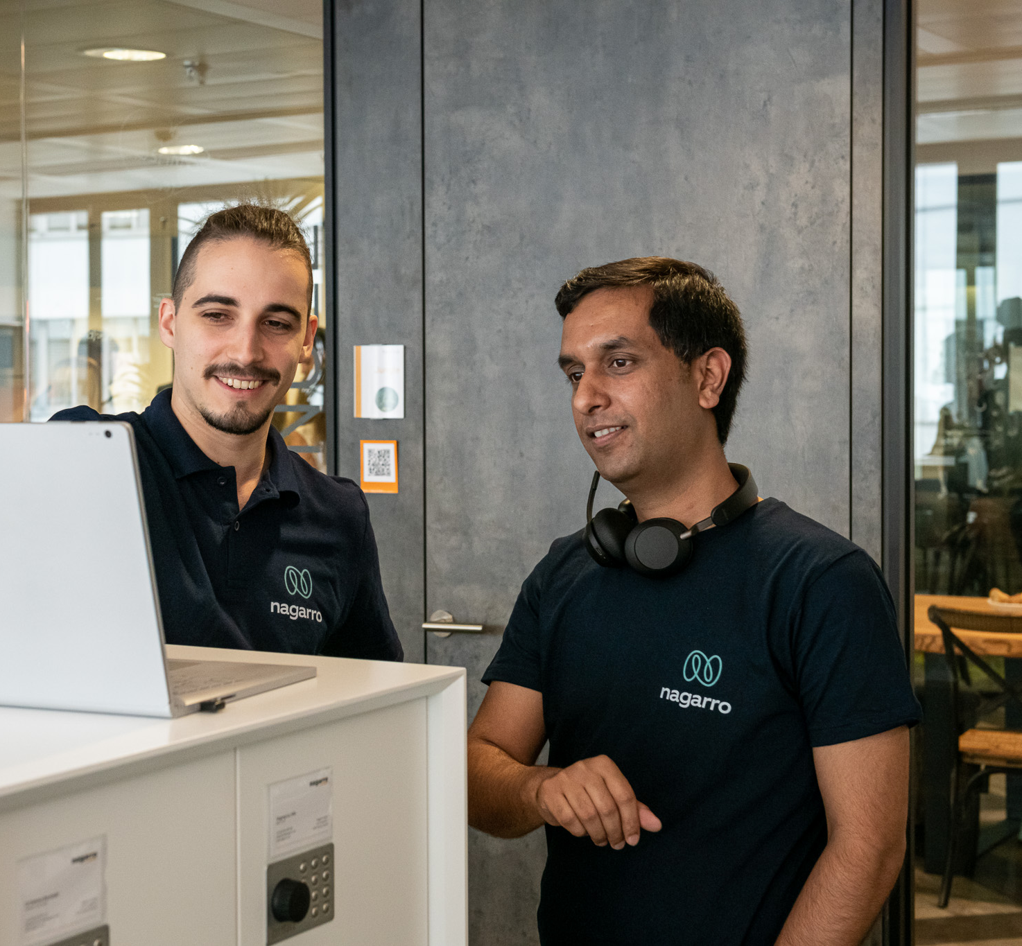
Agenda
Introduction
Features
Technology
Security
Conclusion
Future Scope
© 2024 – Nagarro – All rights reserved

Slide 3
Introduction:
Welcome to the Expense Management System, a comprehensive web application designed to streamline and simplify group expense management. This system allows users to effortlessly create and track expenses, split costs among group members, and settle balances with ease. Built using .NET Core for the backend and Angular for the frontend, the application ensures a seamless user experience. Additionally, robust unit testing with xUnit and Moq guarantees the reliability and accuracy of its features.

Slide 4
Challenges and Solution:
Problem Statement -
Tracking Challenges: Managing shared expenses among friends or group members is often difficult and can lead to inaccuracies.
Unequal Distribution: Uneven sharing of financial responsibilities frequently results in confusion and disputes.
Administrative Burden: The manual process of calculating and updating balances can be time-consuming and prone to errors, exacerbating conflicts.
Purpose -
Automated Processes: The application automates group creation, expense entry, and balance updates, reducing the need for manual input.
Reduced Errors: By minimizing manual work, the application decreases the likelihood of errors, making expense management more accurate and dependable.

Slide 5

Features

Slide 6
Group Management:
Create New Groups: Users can easily set up new expense-sharing groups.
Unique IDs: Each group is assigned a unique identifier.
Member Limits: Groups have a set limit on the number of members to ensure organized management.
Our application allows users to effortlessly create new expense-sharing groups. Each group is assigned a unique ID and has a limit on the number of members which is 10, which ensures organized and efficient management. This feature simplifies the setup of expense-sharing arrangements and ensures that each group is distinct and well-organized.

Slide 7
Expense Management:
Add and Categorize Expenses: Users can input and classify expenses within each group.
Capture Details: Each expense includes essential information such as description, amount, and payer.
Balance Calculation: The system automatically calculates and displays each member’s balance.
Show Amounts Owed and Owns: Clearly shows how much each member owes or is owed by others.
Moving on to Expense Management, our application allows users to add and categorize expenses seamlessly within each group. For each expense, users can provide essential details such as a description, amount, and the person who paid.
The system then takes over, automatically calculating and displaying each member's balance. It clearly shows the amounts each person owes or is owed, simplifying the tracking and management of shared costs.

Slide 8
Expense Settlements & User Access:
Expense Settlements: Users can mark expenses as settled, and the system will automatically update the balances for each member.
User Authentication:
Secure Login: Ensures that only authorized users can access the system.
Role-Based Access: Differentiates between Admin and Normal users, restricting actions based on their roles.
Next, let's discuss Expense Settlements and User Access. Our application allows users to mark expenses as settled. Once marked, the system automatically updates the balances for each member, ensuring accurate and up-to-date financial records.
For user security and management, the application features secure login to protect access. Additionally, it includes role-based access control, distinguishing between Admin and Normal users, and ensuring that actions are restricted according to their roles.

Slide 9
Technology

Slide 10
Backend Technology
Frontend Technology
.NET Core
Description: A powerful, cross-platform framework for building robust and scalable backend services.
Key Benefits: High performance, modern development
Entity Framework
Description: An Object-Relational Mapping (ORM) framework that simplifies database interactions.
Key Benefits: Reduces boilerplate code, provides LINQ support, and enables code-first or database-first approaches.
Angular
Description: A popular framework for building dynamic and responsive web applications.
Key Benefits: Rich feature set, two-way data binding, and a component-based architecture.

Slide 11
Database Technology
Testing Tools
xUnit and Moq
Description: xUnit is a testing framework for .NET, and Moq is a mocking library used for unit testing.
Key Benefits: xUnit supports a wide range of testing scenarios, while Moq facilitates the creation of mock objects to test components in isolation.
MSSQL Server
Description: A relational database management system designed for high performance and reliability.
Key Benefits: Advanced querying capabilities, strong data security, and integration with .NET technologies.

Slide 12
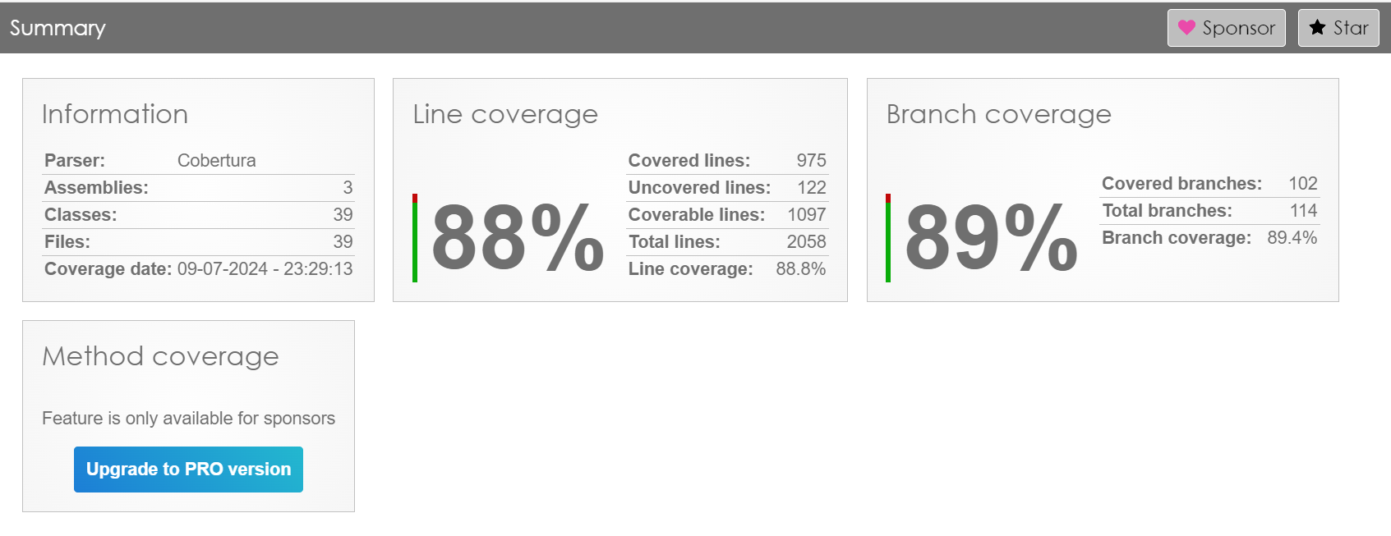
Unit Test Case Report:

Slide 13
Security

Slide 14
We have implemented robust security measures, including secure authentication to verify user identities, role-based access control to restrict permissions based on user roles, and data encryption to safeguard sensitive information.
Data encryption
Implementation of encryption algorithms (bcryte) to secure sensitive user data during transmission and storage
User authentication
Implementation of secure authentication methods (JWT Auth) to protect user accounts from unauthorized access
Access control
Role-based access control to ensure that users can only access relevant information and perform authorized action

Slide 15
Conclusion

Slide 16
Conclusion:
Effective Solution: Offers a powerful and efficient way to handle shared expenses within groups.
Core Features: Provides user profiles, expense tracking, and group management functionalities.
Strong Technology Base: Built with a secure backend using .NET Core and a dependable MSSQL Server database.
Minimized Conflicts: Reduces financial disagreements among group members, encouraging smooth expense sharing.
Future Prospect: Plans for enhancements may include AI-driven expense categorization, smart budget management notifications, and integration with emerging payment technologies.

Slide 17
Future Scope

Slide 18
Future Scope:
AI-Driven Features: Implementing artificial intelligence for automatic expense categorization and predictive analytics.
Enhanced Notifications: Developing smart notifications for budget tracking and financial alerts.
Payment Integrations: Adding support for new and emerging payment platforms to streamline transactions.
Expanded Reporting: Offering advanced reporting and analytics tools for better financial insights.
Scalability Improvements: Enhancing performance and scalability to support larger groups and more complex use cases.

Slide 19
Thank You

